Slide 1
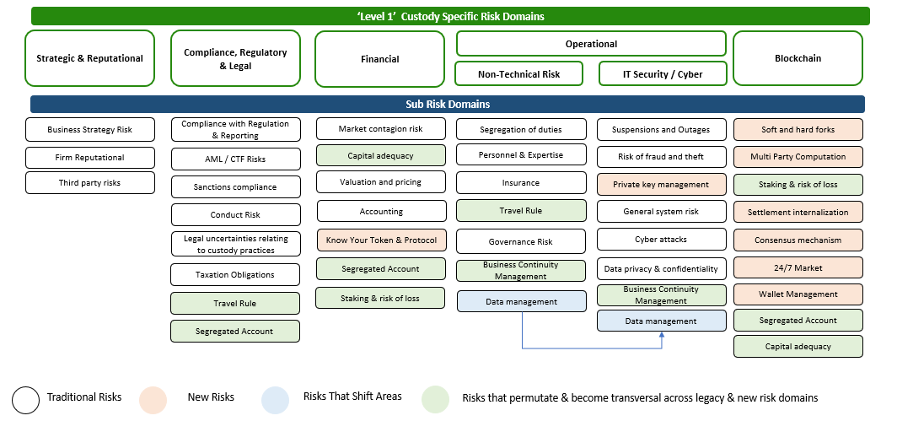
ISSA Symposium 2023
Custody Risk Domains – Traditional and Digital Assets (Source: Deloitte)

