Slide 1
T+1 Coordination Committee
T+1 governance pre-launch meeting
10 December 2024
ESMA ReGular USE

Slide 2
Content
Coordination committee working arrangements
Elements of timeline

Slide 3
1. Working Arrangements for the Coordination Committee

Slide 4
Proposed T+1 governance structure (provisional)
T+1 Coordination Committee
T+1 Industry
Committee
Technical Workstreams of the T+1 Industry Committee
ESMA (Chair)
Independent chair
Trading
Asset management
European Central Bank
European Commission
Chairs/Rapporteurs of TWs
Clearing
Funding and FX
Chair of T+1 Industry Committee
+ as needed, any other relevant stakeholders
Settlement
Securities financing
+ as needed, any other relevant stakeholders
Active observers
Matching & confirmation
AMI-SeCo Corporate Events Group
EC
ECB
ESMA
Other (TBC)
NCAs (BoS/MSC/CSDR TF)
ESCB/AMI-SeCo/ T2S Gov.
EP/MS
Note: the Working Arrangements will provide more details.

Slide 5
Working arrangements
Tasks and responsibilities
Ensure coordination between the industry and the authorities so that all stakeholders pull in the same direction for the EU to achieve T+1 by 11 October 2027, in particular by:
Confirming, based on input from the industry committee, the timeline for key deliverables from the industry
Monitoring the progress of the transition to T+1, based on reporting from the industry committee
Facilitating dialogue on any identified challenge or blocking issue that is escalated by the industry committee
In case no consensus can be found on a blocking issue at the level of the industry committee, if possible, providing informal advice on that issue
International coordination
Liaise with authorities (European jurisdictions and beyond) to promote a coordinated approach and facilitate an orderly transition to T+1

Slide 6
Working arrangements
Composition of the Coordination Committee:
The ESMA Chair
An EC Representative
An ECB Representative
The Industry Independent Chair
Chaired by the ESMA Chair
Secretariat provided by ESMA
External stakeholders might be invited to the meetings of the Coordination Committee on specific subjects

Slide 7
Working arrangements
Working methods, Transparency and Confidentiality
Meetings on a quarterly basis, or more frequently if required
Decisions by consensus
Each authority in the Coordination Committee will ensure appropriate information flows in accordance with their respective governance
All members of the Committee and meeting participants will be under the obligation to respect confidentiality

Slide 8
Public communication
A dedicated webpage on ESMA website to publish:
General explanations on the T+1 governance structure
The Coordination Committee Working arrangements
The Composition of the Coordination Committee
After each meeting, the summaries of conclusions of the Coordination Committee’s meetings
Contact email T1@esma.europa.eu

Slide 9
2. Elements of timeline

Slide 10
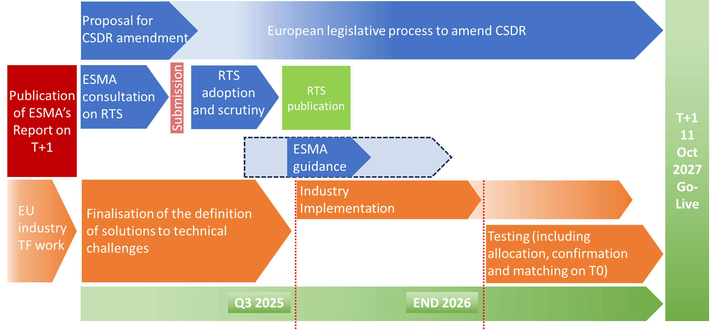
Proposed overall timeline to move to T+1

Slide 11
T+1 related regulatory work: overview
L1
CSDR (EC proposal)
L2
ESMA RTS on settlement discipline and tools to improve settlement efficiency
EC Delegated Act on the scope of settlement discipline (based on ESMA technical advice)
L3
Guidelines on standardised procedures (allocation and confirmation) (ESMA)
EC Delegated Act on penalty rates (based on ESMA technical advice)

Slide 12
T+1 related regulatory work: timeline
L1, L2 (DAs): new Commission to determine
L2: RTS on settlement discipline
Public consultation
Mid-Feb - Mid-April 2025
Draft RTS submission to the EC
End Q3 2025
Adoption by the EC,
EP+Council scrutiny
OJ
at the earliest Q1 2026

Slide 13
T+1 related regulatory work: scope
CSDR
Article 5(2) on T+1
Transition date
RTS on settlement discipline
Allocation and confirmation deadlines
CSD functionalities: partial settlement, hold and release
Additional tools to improve settlement efficiency
Other aspects TBD

Slide 14
T2S: timeline for T+1 related changes
Any changes to T2S and most likely to many systems in the full transaction chain (e.g. CSDs, CCPs, intermediaries), will typically need to be planned between Q4 2025 and June 2027(T2S and CSDs/DCPs major releases).
It is not clear at this stage what exact changes may be needed in T2S (needs to be clarified first in the new T+1 governance and ultimately decided by the T2S governance/MIB).
T2S governance has started already the internal work (ESMA Report is a good basis for starting this analysis).
Clarification on the market recommendations (and clarity on direction of RTS) needs to be stable by Q1, latest Q2 2025 (so that the actual T2S Change and Release management process can start with priority).

Slide 15
Thank you!

